Slide 1
Deep Q-Networks
and
Its Variants
Bilal Piot and Corentin Tallec
01/04/2021

Slide 2
Programme of the talk

Slide 3
Programme of the talk
Part 1: DQN Deep Q-Networks
  Context and History:
    Context
    The milestones: from Value Iteration to DQN
    Environment and Results
  Theory:
    Reminder of the Value Iteration algorithm
    Approximate Value Iteration
    Neural Fitted-Q algorithm
    From Neural Fitted-Q to DQN
  Practice:
    Overview of a DQN Implementation

Slide 4
Programme of the talk
Part 2: DQN and Its Variants
  DQN and its variants: an overview of the literature:
    Algorithmic Improvements:
      DDQN
      Prioritized Replay
      Distributional RL
    Architectural Improvements:
      Dueling DQN
      Distributed Agents
    Memory:
      Working Memories
      Episodic Memories
    Exploration:
      Never Give Up Agent
    Meta Controllers:
      Bandit
      Meta-gradient RL
    Agent57: Combining all the known improvements.

Slide 5
Part 1: DQN
Deep Q-Networks

Slide 6
Context and History

Slide 7
Context
Control Theory:
  Aims at guiding “safely” and “rapidly” a dynamical system to a desired state.
  Has been one of the major advances in engineering in the 20th century:
    Aviation
    Manufacturing
    Electronics
    Energy
  Works extremely well when those conditions are met:
    Knowledge of the state variables (features)
    Knowledge of their dynamics
Reinforcement Learning (RL):
  A general paradigm for control theory when the model of the world is unknown.
  Has the potential to tackle complex control theory problems:
    High dimensional state-action spaces
    Partial observability
  Deep Q-Network was one of the papers that reignited the interest in RL as a general solution to control theory.

Slide 8
Milestones: From Value Iteration to DQN
Value Iteration in stochastic games (Shapley 1953) and Markov decision processes (Bellman 1957):
  Computes the optimal value of an MDP.
  The proof relies on fixed-point theory: Banach contraction theorem (1922).
Approximate Value Iteration:
  Bounds in infinity norm: Bertsekas and Tsitsiklis (1996)
  Bounds in Lp norm: Munos (2007)
Fitted-Q Algorithms:
  Fitted-Q with random forests: Ernst (2005)
  Neural fitted-Q: Riedmiller (2005)
Atari as an environment:
  ALE: Bellemare (2012)
Deep Q-Network:
  Scaling Neural fitted-Q to Atari games: Mnih (2013)

Slide 9
The Environment: ALE
The Arcade Learning Environment (ALE) is the environment chosen for DQN:
Around 50 Atari games
Raw observations:
  RAM: 128 bytes (0-255)
  2D-RGB image: 160x210x3, 100 800 bytes
Raw actions: 18 discrete actions (0-17)
Rewards: deltas of the score of the game
Frequency: 60 Hz
Length of a game: 30 minutes or more
Why is it interesting:
  Huge state space
  No canonical meaningful features
  Very long optimization horizon

Slide 10












Preprocessing:
The algorithm DQN is almost end to end:
Preprocessing of an observation is done in this order (Reduce the computation):
  No RAM state in the observation, keep only the image: [160, 210, 3]
  Take the maximum for each pixel of image at time t and t-1: [160, 210, 3]
  Extract the luminance from the RGB: [160, 210, 1]
  Downscale the image to 84x84: [84, 84, 1]
Stacking of the 4 previous preprocessed observation (Reduce the partial observability): [84, 84, 4]
The stack of the preprocessed observation is the input of the DQN algorithm.
The output of DQN is the action at 15 Hz frequency which means that there is an action repeat of 4.
Environment:
Image: [160, 210, 3]
RAM: 128 bytes
Preprocessing:
Image: [84, 84, 1]
Stacking:
Input: [84, 84, 4]
DQN
Output: (0-17)

Slide 11
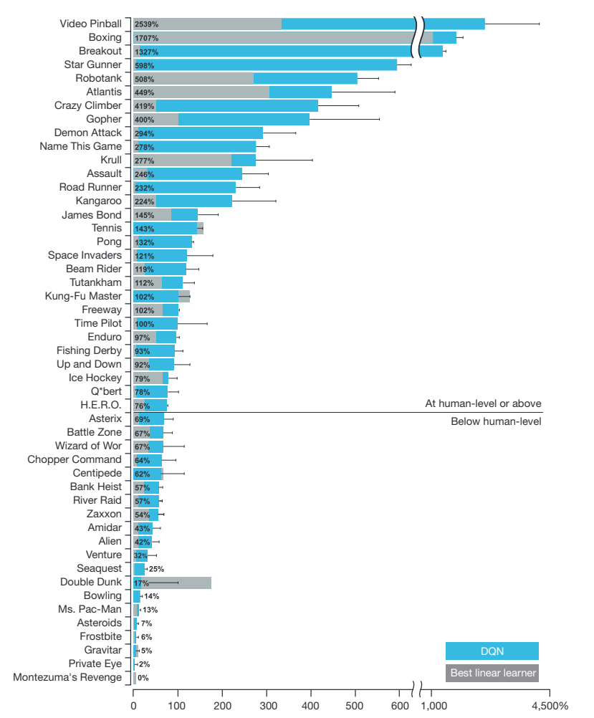
The results:

Slide 12
Theory

Slide 13


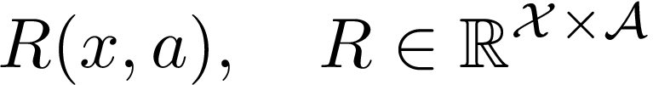
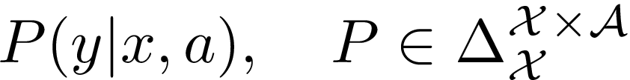

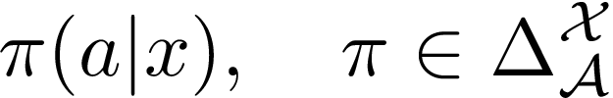
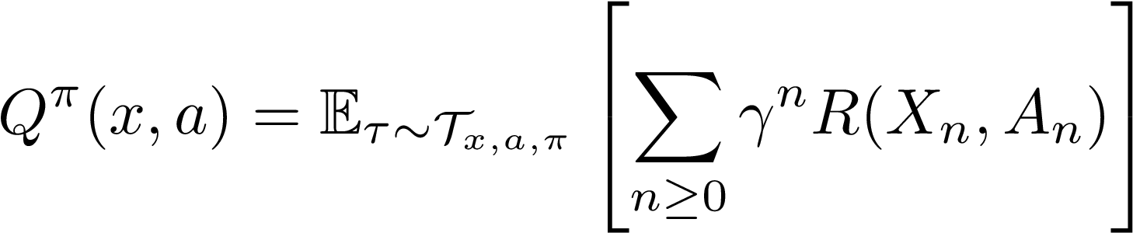




Reminder of the Value Iteration (VI) Algorithm: Theoretical setting.
We consider the control problem in a finite Markov Decision Process
States:
Actions:
Reward function:
Transition kernel:
Discount factor:
We are looking for a stationary policy
that maximises the expected discounted sum of future rewards represented by the state-action value function:
where is the distribution over trajectories following policy and starting
from .

Slide 14
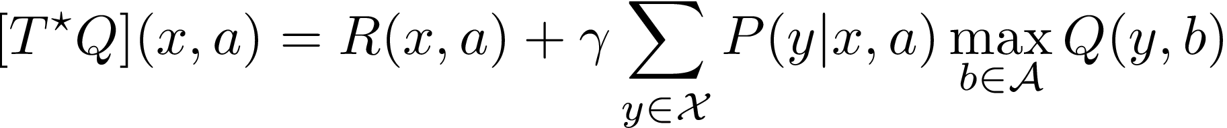



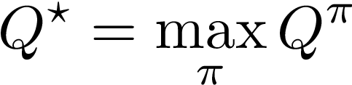
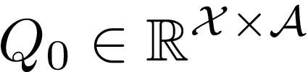
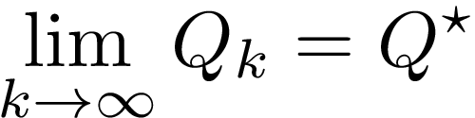
Reminder of the Value Iteration (VI) Algorithm: Formulation
Let us define the optimal Bellman operator :
This operator is a contraction, therefore such that
In addition, corresponds to the maximum of the state-action value function:
To compute one can follow the contracting discrete scheme called Value Iteration:
Initialisation:
VI recurrence:

Slide 15
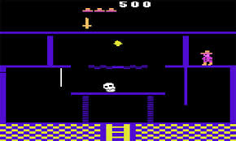



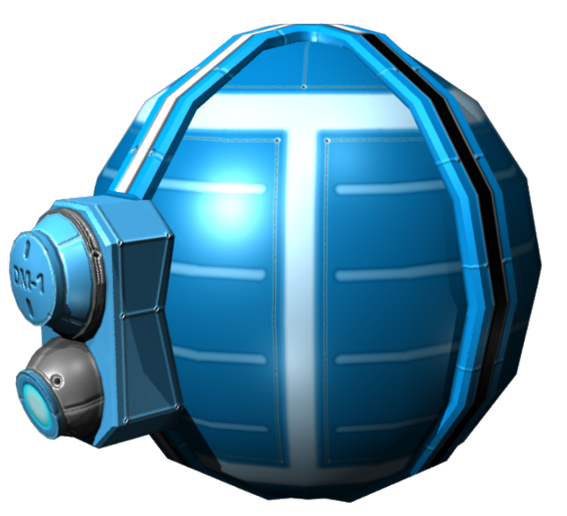

Real-world setting: Interactive Environments

Slide 16

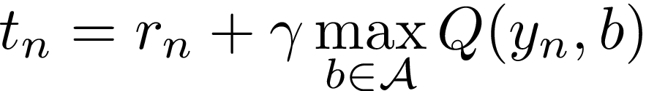


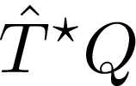
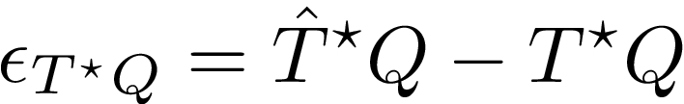
From Value Iteration to Approximate Value Iteration
PROBLEM: Applying the VI recurrence is impossible in a real-world setting:
State-action spaces can be too large!
Dynamics are not fully known!
States and actions can’t be trivially collected, they need to be reached by a non trivial policy (locality problem).
However, the optimal Bellman operator can be evaluated on a known dataset of already visited transitions:
The evaluations (also called targets) are unbiased estimates of
Therefore, we can build the following regression dataset:
Regression Algorithm

Slide 17





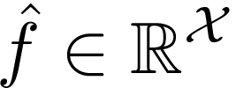
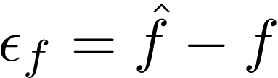
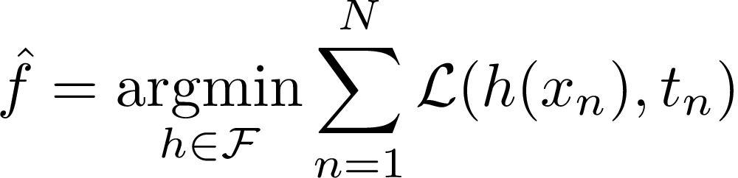
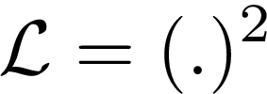

Reminder on Regression
In regression, we have:
a set of points
and noisy but unbiased estimates also called targets of a function
The goal is to retrieve this function with minimal error. More precisely:
with
From the dataset a regression algorithm output a function .
The regression error is defined as . One instantiation of a regression algorithm is:
with regression loss and functional space

Slide 18
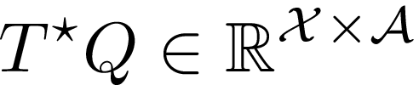
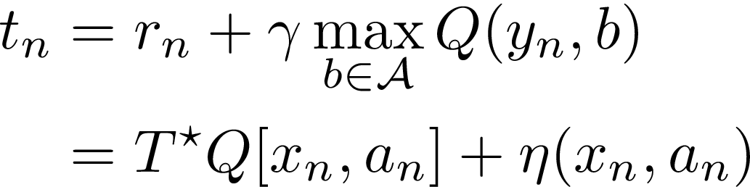
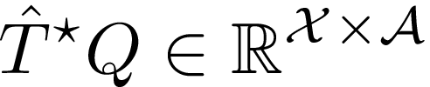
Approximate Value Iteration step seen as a regression
Regression Notations
Approximate VI step Notations

Slide 19
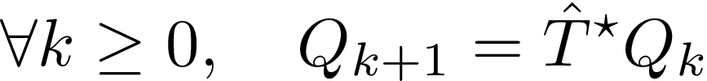
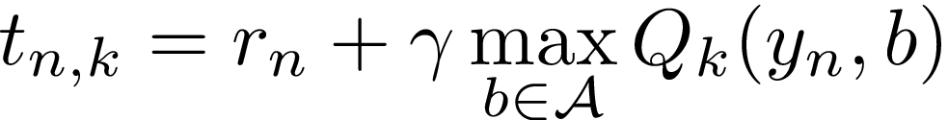

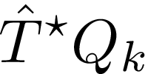
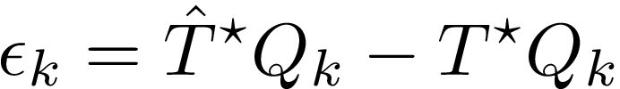
Approximate Value Iteration (AVI): Formulation
The AVI recurrence step consists in two steps:
Build a regression dataset:
  Collect a dataset of transitions:
  Compute unbiased estimates of the optimal Bellman operator:
  Create the regression dataset:
Apply a regression algorithm of your choice:
Initialisation:
AVI recurrence:
Regression Algorithm

Slide 20
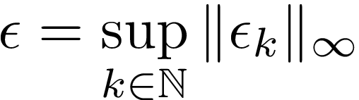
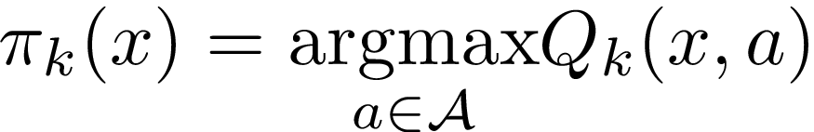
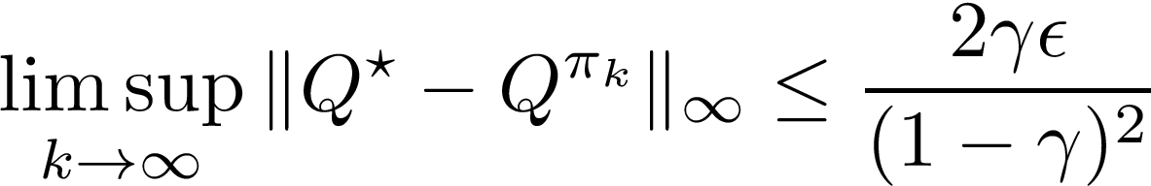
Approximate Value Iteration (AVI): Bounds
Let be the supremum in infinite norm of the regression errors and let us define
the greedy policy:
then, we have the following bound:
This is a bound in infinite norm, for tighter bounds with other norms see:
Munos 2007: https://hal.inria.fr/inria-00124685/document
Scherrer 2014: https://hal.inria.fr/hal-01091341/document

Slide 21
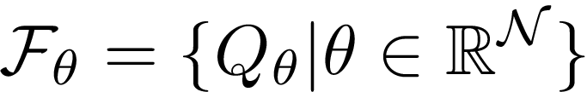

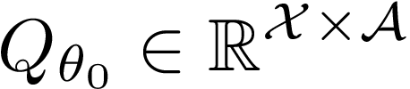
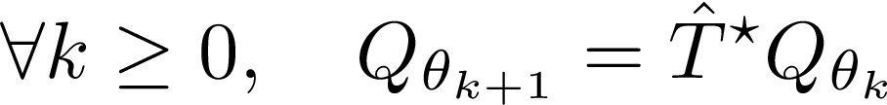
Neural Fitted-Q: Intro and Notations
Neural Fitted-Q (Riedmiller 2005) is an instantiation of AVI where the regression algorithm have the following properties:
The functional regression space is parameterized by a neural network.
The loss function is a squared-like loss.
The optimizer is SGD-based (Rprop for the original but could be Adam).
The data used for regression was often a fixed batch of data.
Initialisation:
Neural Fitted-Q recurrence:

Slide 22
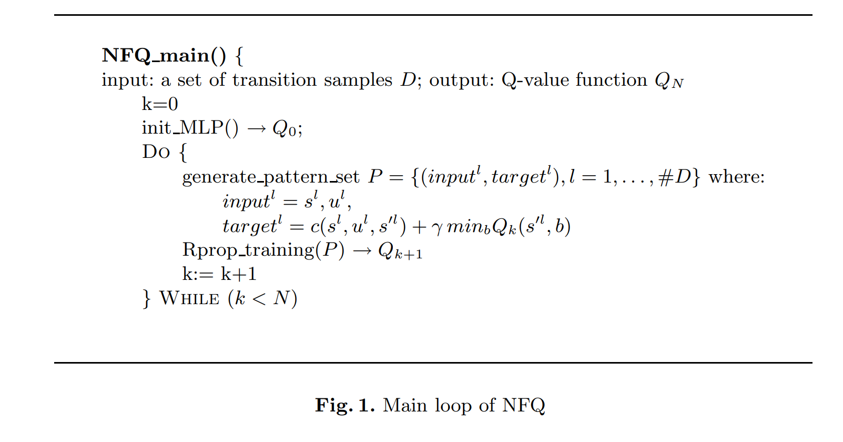
Neural Fitted-Q: original pseudo-code.
Initialisation:
Neural Fitted-Q Recurrence:
Building the regression dataset
Regression algorithm

Slide 23
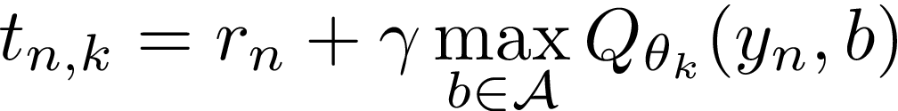
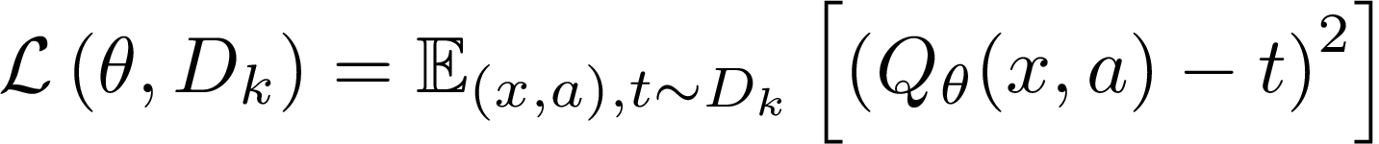
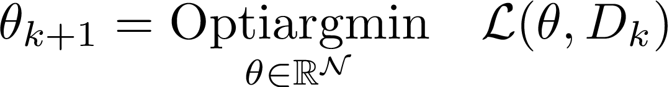
Neural Fitted-Q: an overview.
The Neural Fitted-Q recurrence follows the same pattern as the AVI one:
Build the regression dataset:
  Collect a dataset of transitions:
  Compute unbiased estimates of the optimal Bellman operator:
  Create the regression dataset:
Apply regression with squared loss and optimize it with an SGD-based optimizer:

Slide 24






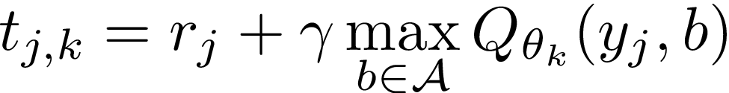
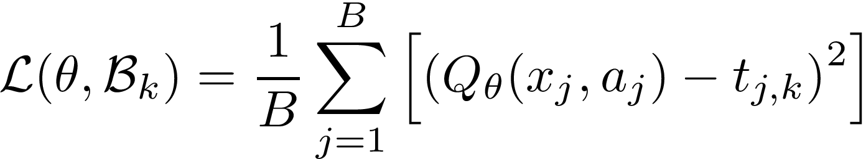

Neural Fitted-Q: in details.
Here we show how we compute in details the regression
The expected squared loss will be approximated by where is a batch of data.
Then, the optimization will consists of a fixed number of SGD-like steps performed by an optimizer:
Initialisation:
For :
  Draw uniformly a batch of transitions from the dataset:
  Compute the targets:
  Form the regression batch:
  Compute the loss:
  Take a SGD-like step:
Update the parameters:

Slide 25





From Neural Fitted-Q to DQN
From Neural Fitted-Q to DQN, only some small changes but a 8 year gap:
Data collection: going from a batch dataset to a replay buffer filled by the online policy. Acting and Learning are done simultaneously.
Architecture: Bigger neural network architecture.
Optimization: Using RMSprop.
Some vocabulary introduced by DQN but the underlying concepts were already existing:
Online network: The neural network that optimizes the loss.
Target network: The neural network of the previous AVI iteration with fixed weights.
Online policy: The policy that collects the data.
Replay buffer: The collections of transitions from which the batches are samples.
Update period: How many steps of gradients are taken before going to the next AVI iteration.

Slide 26
DQN: an overview
Replay Buffer(FIFO)
Batch
Transition
Neural Fitted-Q
Environment
Action

Slide 27
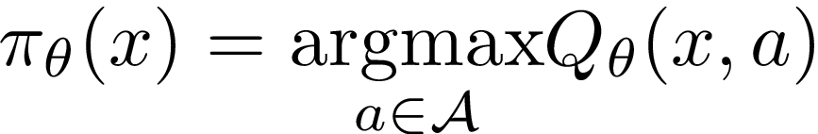




DQN: the data collection (Acting).
In DQN, the data is collected via the epsilon-greedy online policy:
Greedy-policy:
Uniform policy:
Epsilon-greedy policy:
Start an episode at and collect an episode following the policy :
Replay Buffer (FIFO)

Slide 28
DQN: the regression step (Learning).
Here we show how we compute in details the regression
Then, the optimization will consists of a fixed number of SGD-like steps performed by an optimizer:
Initialisation:
For :
  Draw uniformly a batch of transitions from the replay:
  Compute the targets:
  Form the regression batch:
  Compute the loss:
  Take a SGD-like step:
Update the parameters:

Slide 29


DQN: Architecture.
Conv Kernel:8x8
Stride:4x4 Channels:32
+
RELU
Conv Kernel:4x4 Stride:2x2 Channels:64
+
RELU
Conv Kernel:3x3
Stride:1x1 Channels:64
+
RELU
Fully Connected (Units: 512)
+
RELU
Fully Connected (Units:18)

Slide 30
Practice

Slide 31
DQN Zoo Codebase
Material:
The DQN Zoo codebase
Information:
The codebase is open source and developed by DeepMind (John Quan and Georg Ostrovski)
The code is in Python, JAX, Haiku and Rlax.
It tries to reproduce results of DQN and some of its variants on Atari:
  DQN
  DDQN
  Prioritized Experience Replay
Can be installed on a machine with a single GPU
Comes with a run function and plotting tools
Each agent comes with:
  A class describing the agent
  A run function
  A test function

Slide 32
Inspecting the DQN code
Questions:
In which file the learning/interaction loop is implemented?
In which file the DQN agent functions are defined?
In which library can I find the DQN loss?
How the networks parameters are updated?
How is the replay implemented?
Where is the preprocessing done?

Slide 33
Exercice
From the DQN code write its pseudo code.

Slide 34
Part 2: DQN
and its Variants

Slide 35
DQN and its variants:
an overview of the literature

Slide 36
Improvements to DQN
Since 2015, several improvements have been made:
Algorithmic improvements:
  Double DQN
  Prioritized replay
  Distributional RL
Architectural improvements:
  Dueling architecture
  Distributed setting
Memory additions:
  Working memories: LSTM, GRU
  Episodic memory
Exploration mechanisms:
  An entire literature on this topic has been developed since the 90’s
Meta-controller:
  Bandits
  Meta-gradients
  Population-based training

Slide 37
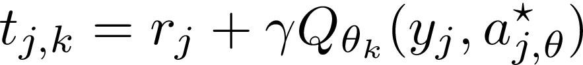
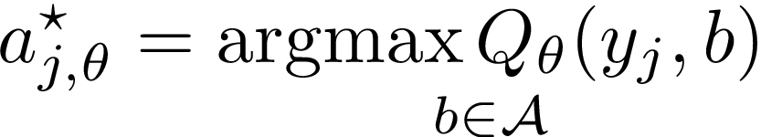
Double DQN (DDQN)
Material:
Double Q Learning paper
Double DQN paper
The Problem: Q Learning has been shown to overestimate its targets, because it uses a single estimator for estimating the Q values and choosing the maximum over actions.
The Solution: To overcome this, Double Q Learning uses a double estimator technique.
The double estimator technique disentangle the estimation of the Q values from the choice of the maximum over the actions:
The target network is used for estimation.
The online network for choosing the greedy action.
becomes where

Slide 38

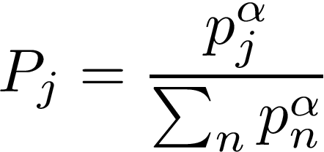
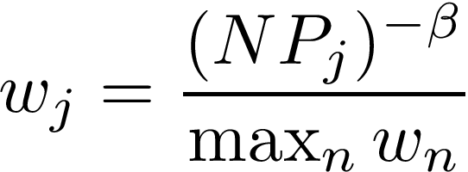
Prioritized Experience Replay
Material:
Prioritized Experience Replay paper
The Idea: Prioritize transitions with high TD errors and weight those transitions adequately to eliminate the introduced bias.
TD error:
Priority:
Probability of being selected:
Loss reweighting:

Slide 39
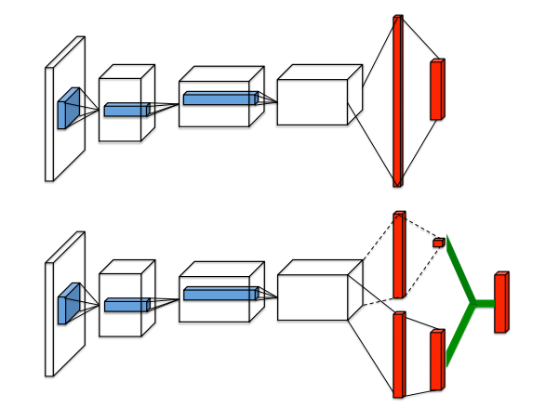
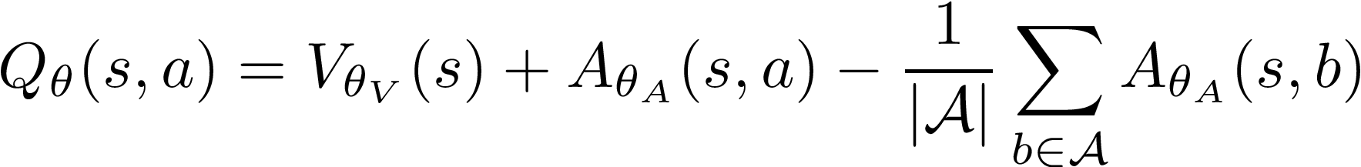
Dueling Architecture
Material:
Dueling network architecture
The Idea: Decompose the Q value into a state-dependent part and a state-action dependent part.
The effect: This allows to share the state-dependent estimations (good for actions that are less chosen), focuses in estimating the state-action dependent part (good for relative ranking of the actions).

Slide 40
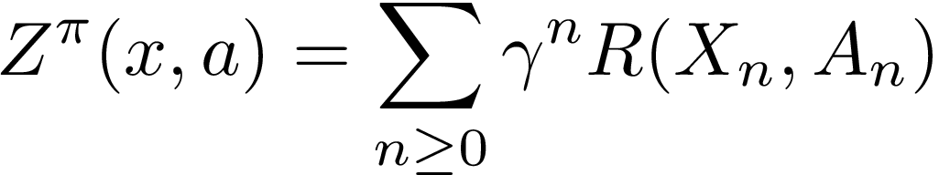
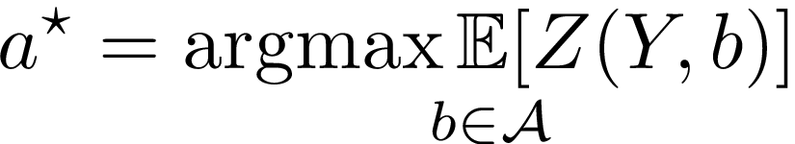
Distributional RL
Material:
Categorical Distributional RL paper
Implicit Quantile Network paper
Dopamine Blog
The Idea:
Learn the distribution of the discounted return.
Still act according the expected discounted return.
Why it works:
Learning the full distribution is a natural auxiliary task for better representation learning.
Distribution of returns of a given policy:
Distributional Bellman Operator:

Slide 41
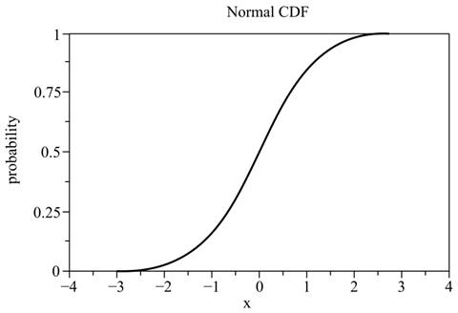


Distributional RL in a nutshell!
To learn a distribution of a real random variable you need to learn the cumulative distribution function:
Categorical approach: Learning the probabilities by counting!
Quantile approach: Learning the quantiles with quantile regression!

Slide 42
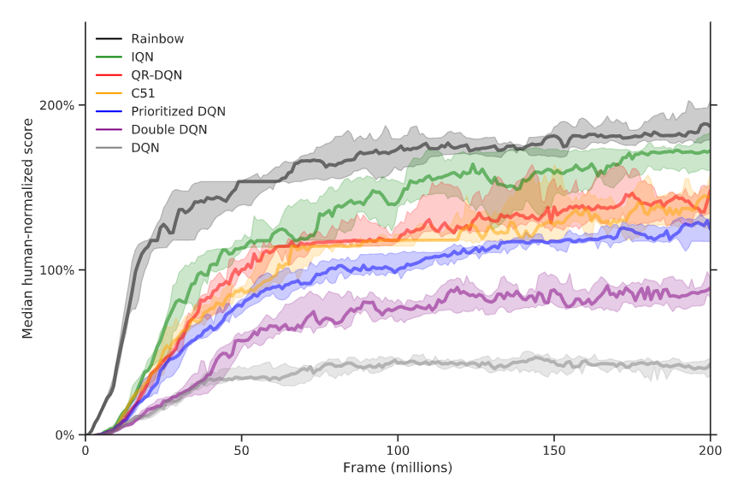
Results for DQN-based non-distributed agents

Slide 43
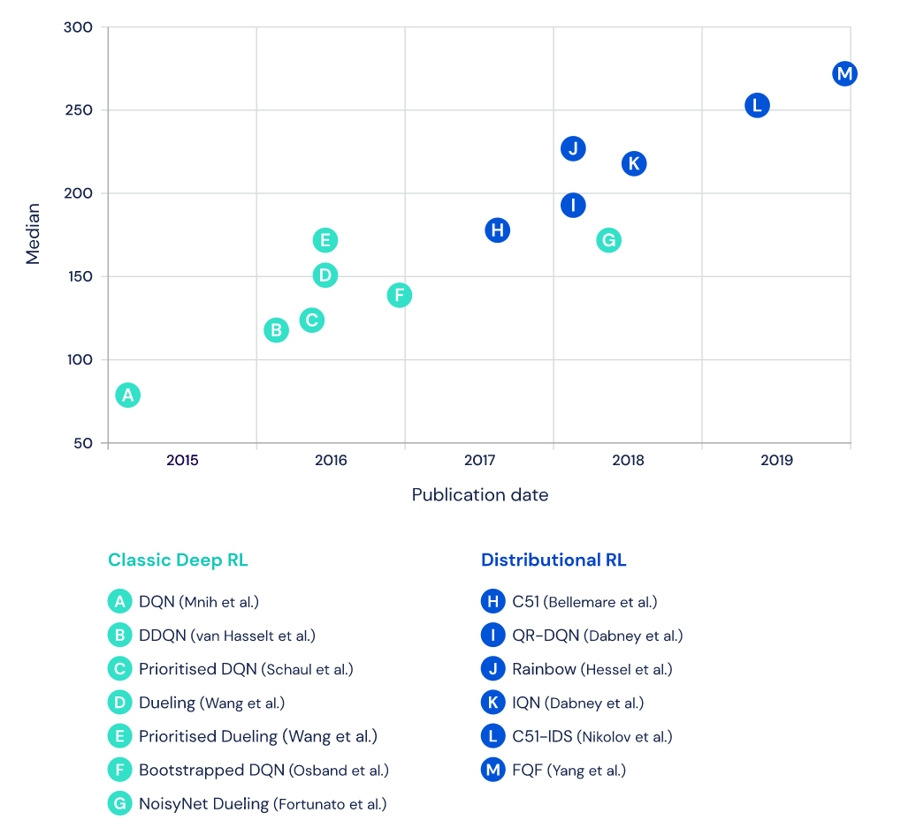
Results for DQN-based non-distributed agents

Slide 44
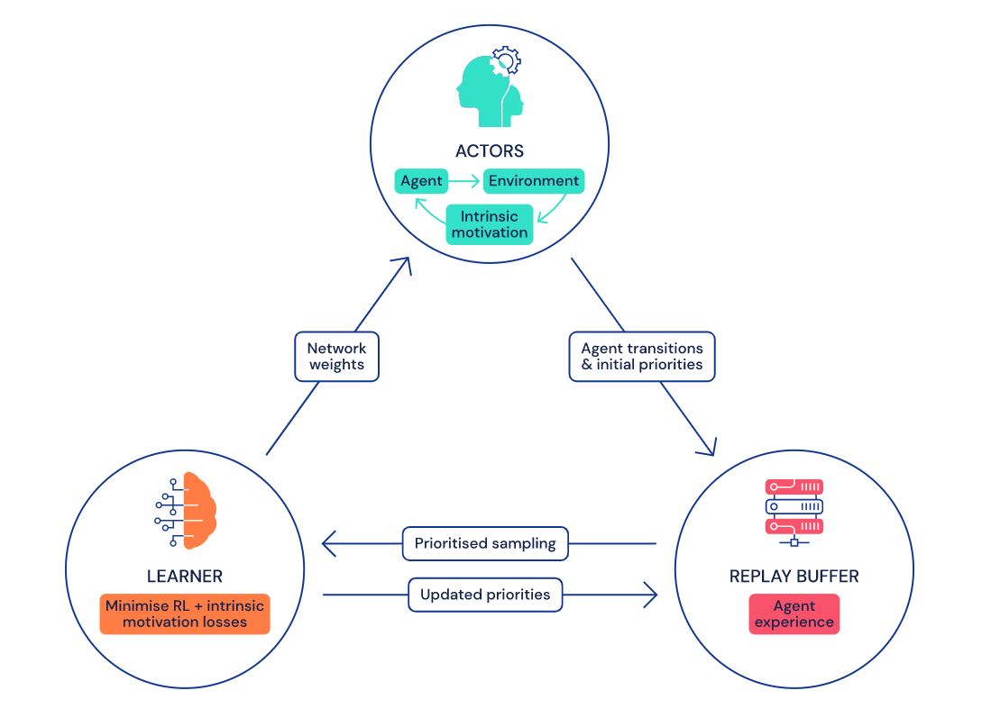
Distributed Setting
The Idea: Decoupling the learning from the data collection.

Slide 45








Working Memory
Material:
R2D2 paper
The Idea:
Use a recurrent neural network to tackle the partial observability problem.
Q-head
Q-head
Q-head
Q-head
LSTM
LSTM
LSTM
Conv Torso
Conv Torso
Conv Torso
Conv Torso

Slide 46


R2D2 results

Slide 47
Exploration
Reinforcement Learning is not only about maximizing the known rewards (exploitation) but also about finding new rewards (exploration).
Exploration mechanism in DQN: epsilon-greedy
There is an entire literature on improving this basic exploration mechanism:
Uncertainties estimation: Use the uncertainty about the world as an incentive for exploration.
  State uncertainty: Random Network Distillation
  Future uncertainty: Prediction error
  Model uncertainty: Model disagreement
  Value uncertainty: Uncertainty Bellman Equation
Entropy maximisation:
  Episodic entropy maximisation: Never Give Up
  Global entropy maximisation: Geometric Entropy Maximisation

Slide 48



Never Give Up Episodic bonus
Build controllable states: self-supervised inverse dynamics model
Compute an estimate how familiar is a given state.

Slide 49

Never Give Up: complete exploration bonus

Slide 50


Meta-Controller
Arms:
Rewards:
Episode Score

Slide 51
Agent57: Combining most improvements
Agent57 combines:
Prioritized replay
Dueling architecture
Separated Q values, one for exploration and the other for exploitation
Distributed actors
Episodic Memory
Working Memory conditioned on hyperparameters optimized by the Meta-Controller
Exploration: Never Give Up
Meta-Controller: Bandit

Slide 52



Agent57: results

